Slide 1
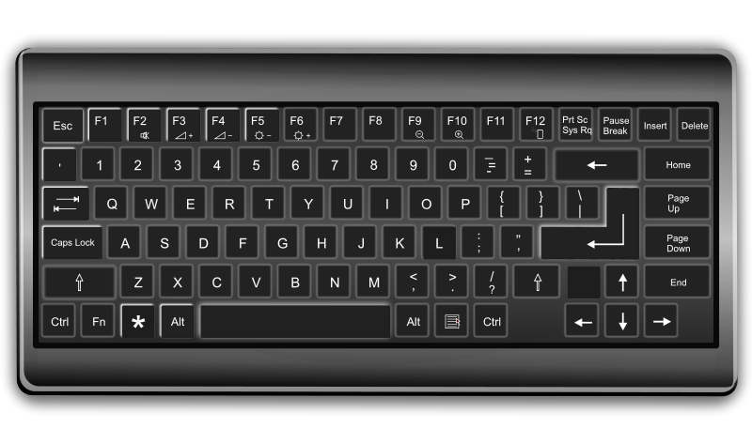

Slide 3









Switch camera
PAUSE
decelerate
Accelerate
flip
Move vehicle
Back (menu)
Select (menu)
Lay stun trap
Lay damage trap

Slide 4
